Slide 1
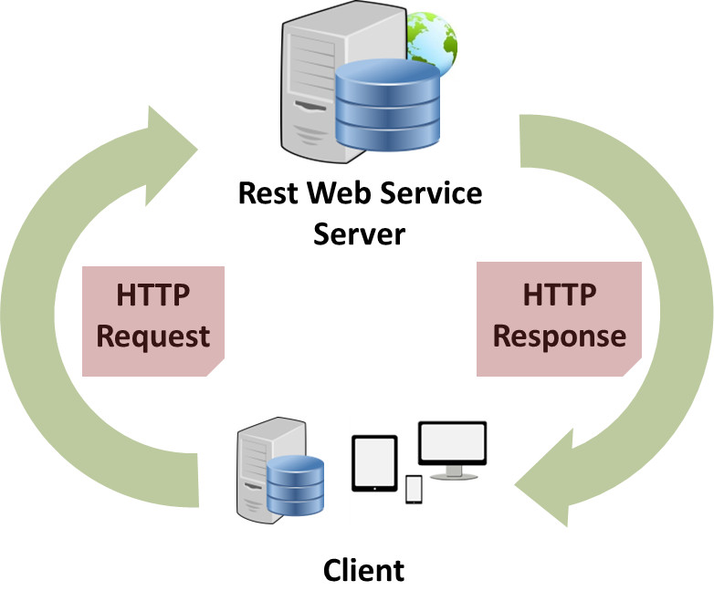
RESTful Web Services
Shikha Desai

Slide 2

Web Services
Are services exposed to the internet for programmatic access.
Web services (sometimes called application services) are services (usually including some combination of programming and data, but possibly including human resources as well) that are made available from a business's Web server for Web users or other Web-connected programs.
e.g., online APIs of facebook and twitter through which third party applications are able to post to facebook wal or tweet

Slide 3
Types of web services
REST (Representational State Transfer)
SOAP (Simple Object Access Protocol)

Slide 4

Web Service Characteristics
Normally, the response is a formatted response in form of HTML, CSS
  Client(Human) (HTTP Request) –--> Server
  Client(Human) <–-- (HTTP Response) Server
But in case of web services, it will be just data maybe in form of XML/JSON because here the client is just a program.
  Client (HTTP Request) –--> Web Service
  Human<–-- (Formatted output to some user) Client <–-- (Data) Server

Slide 5
Web Service Characteristics
Protocol
  The format of messages sent and received
  In case of SOAP, the protocol is SOAP itself
  In case of REST, there's no protocol, the communication is through XML/JSON/Text/etc.
HTTP exchange
  The communication between client and server is through HTTP...there are various methods of HTTP such as Get, Post, etc … in case of REST we can use any of these methods, there's no particular rule

Slide 6
Web Service Characteristics
Service Definition
  Definition of the web service
  In case of SOAP, the definition is referred as WSDL (Web Service Definition Language) : its a document which specifies what the service does, the methods, etc.
  In case of REST, there is no such formal definition available, generallt a RESTful web service has little to no documentation.

Slide 7
Web Service Characteristics
SOAP Web Service Specification : has all rules defined for using SOAP web service
REST has no such specification, nor rules... its a concept ...

Slide 8
Representational State Transfer
  Basically its not a web service
  Its an architecture
  So, REST + Web Service = REST Web Service
  There are no strict rules, just guidelines and we follow as much as possible trying to make our web service RESTful.

Slide 9

REST and HTTP
HTTP
  Hypertext Transfer Protocol
  Has a specification (set of rules)
  To exchange info over internet
  It exchanges hypertext
    Hypertext is a text which contains logical links (hyperlink) to other texts
    Way of writing hypertext is HTML (hypertext markup language)
Resource Locations
  RESTful APIs also consists of URLs and links just like a webpage but response is just core data say in XML/JSON
Addresses
  RESTful APIs have Resource based addresses

Slide 10

REST and HTTP
Addresses
  RESTful APIs have Resource based addresses
  Website Address
    Action based
    eg., weatherapp.com/weatherLookup.do?zipcode=12345
  Resource based URI
    Just like looking up directly rather than doing some processing
    They have nouns(messages) not verbs(getMessages)
    Independent of framework used as the client doesn't know which framework is used for development
    eg., weatherapp.com/zipcode/12345
    eg., /profiles/{profileName}
    Resource Relations
      eg., /messages/{messageId}/comments/{commentId}
    Types
      Instance Resource URIs
        eg., /messages/{messageId}
      Collection URIs
        eg., /messages
        Filetering results
          Add query parameters for pagination and filtering
          eg., /messages?offset=30&limit=10

Slide 11
REST and HTTP
HTTP Methods
  The resource URIs don't specify the action unlike website URIs
  The URI tells the resource to be accessed and the method tells what the operation is
  GET method to get something from the server
    To get a resource
    Read only
    Safely Repeatable operation (Idempotent)
      Idempotence is the property of certain operations that can be applied multiple times without changing the result beyond the initial application.
  POST method to post something to the server
    To create a new resource … we do POST request to the collection URI as the Id is not existing currently
    Write
    Not Repeatable operation (Non-Idempotent)
  PUT method to submit something to the server
    To update or change any resource
    Write
    Safely Repeatable operation (Idempotent)
  DELETE method to remove a resource
    Write
    Safely Repeatable operation (Idempotent)
  Whenever a browser refreshes, it repeats the idempotent methods but before repeating the non idempotent ones, it asks the user about surety.

Slide 12
REST and HTTP
HTTP Methods (continued...)
  HEAD
    The HEAD method is identical to GET except that the server MUST NOT return a message-body in the response. The metainformation contained in the HTTP headers in response to a HEAD request SHOULD be identical to the information sent in response to a GET request.
    This method is often used for testing hypertext links for validity, accessibility, and recent modification.
    The response to a HEAD request MAY be cacheable in the sense that the information contained in the response MAY be used to update a previously cached entity from that resource.
  OPTIONS
    The OPTIONS method represents a request for information about the communication options available on the request/response chain identified by the Request-URI. This method allows the client to determine the options and/or requirements associated with a resource, or the capabilities of a server, without implying a resource action or initiating a resource retrieval.
    Responses to this method are not cacheable.
    If the Request-URI is an asterisk (""), the OPTIONS request is intended to apply to the server in general rather than to a specific resource. Since a server's communication options typically depend on the resource, the "" request is only useful as a "ping" or "no-op" type of method
  In case of REST, a good API will use all these methods judiciously unlike SOAP which uses only the POST method.

Slide 13
REST and HTTP
Metadata
  HTTP defines status codes, response headers as a metadata to users alongwith the response
    Status codes
      200(Success)
      500(Server error)
      404(Not Found)
    In case of REST, we need the exact status code as client is a program, it won't understand the error message
  In REST, as any type of data can be transferred,
    There's a header value specifying the metatdata
      content type
        eg., text/xml … application/json
        Content negotiation : process where client tells about expected format so that server can send appropriately

Slide 14
REST Response
XML (Extensible Markup Language)
  eg., a response for a message
    <messageEntity>
    <id> 10 </id>
    <message> Hello world </message>
    </messageEntity>
JSON (JavaScript Object Notation)
  eg., a response for a message
    {
    “id” : “10”,
    “message” : “Hello world”
    }
These responses are different representations of the same resource
  So it is called representational state transfer as we are transferring representations of a resource

Slide 15
REST Response
To specify the representation type, HTTP headers have content Type information
Status codes → first line of response
  It is just : 404 Not Found … 200 OK
  Ranges from 100 to 599 but not all valid
    1xx – Informational
    2xx – Success
      200 OK
      201 Created
      204 No Content
    3xx – Redirection
    4xx – Client Error
      400 Bad Request
      404 Not Found
      415 Wrong Format
    5xx – Server Error
      500 Internal Server Error

Slide 16
HATEOAS
Hypermedia As The Engine Of Application State
Just as websites consist of hyperlinks to various pages and we don't require any documentation to use the website
Similarly, we can have hypermedia/hyperlinks in our response so that it becomes convenient for the client to access the related resources
There is no compulsion on the names of attributes to be used, but you can use standards from the following link :
  http://www.iana.org/assignments/link-relations/link-relations.xml

Slide 17
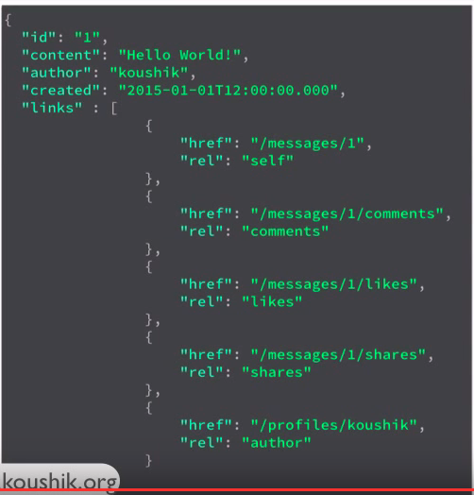
HATEOAS

Slide 18
Richardson Maturity Model
A way for REST APIs to be classified, and the "RESTfulness" of an API determined.
Different levels
Level 0
  One URI
  Request body contains all the details
    Contains which operation and on which data
    eg.,
      <create-message>
        <message-content> Hello World </message-content>
        <message-author> Shikha </message-author>
    Called the swamp of POX (Plain Old XML) → it defines every detail
    Here, we don't need any HTTP concepts as all info is in XML
Level 1
  Resource URI → Individual URIs for each resource
  But still we need to specify the operation
Level 2
  HTTP Methods → Uses right HTTP methods, status codes
Level 3
  Implement HATEOS → Responses have links that the clients can use

Slide 19
RESTful Web Service using Spring Boot
https://spring.io/guides/gs/rest-service/

